Slide 1
19ZO03 - INTRODUCTION TO BLOCKCHAIN TECHNOLOGY

Slide 2
Syllabus
INTRODUCTION: Distributed System, P2P system, Hadoop Distributed File System, Distributed Hash Table, ASIC resistance, issues, Distributed Ledger Technology- Private, public and permissioned ledgers - Cryptographic primitives- public key cryptography- Digital Signature Algorithm -Hashing- Blockchain evolution- Structure of Blockchain – Life of Blockchain application - consensus – Byzantine General problem and Fault Tolerance (11)
BLOCKCHAIN 1.0 - BITCOIN AND CRYPTOCURRENCY : Block Hash - structure of block – syntax , structures, and validation - transaction life cycle- transaction types – Hash computation and Merkle Hash Tree -Bit coin and importance- Creation of coins–Bitcoin P2P Network-, Bitcoin protocols - Mining strategy and rewards – PoW and PoS – Difficulty, hash rate– Wallets- Double spending – forking- Token, Coinbase - practice on MTH (12)

Slide 3
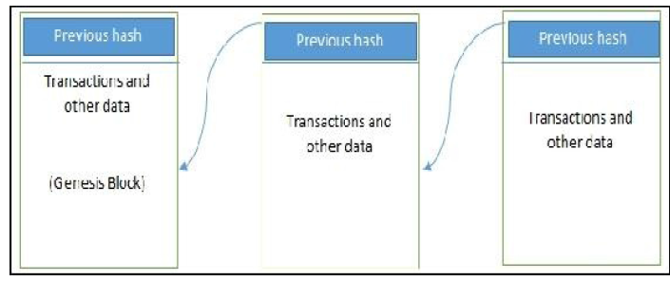
Structure of Blockchain
Generic structure of a blockchain

Slide 4
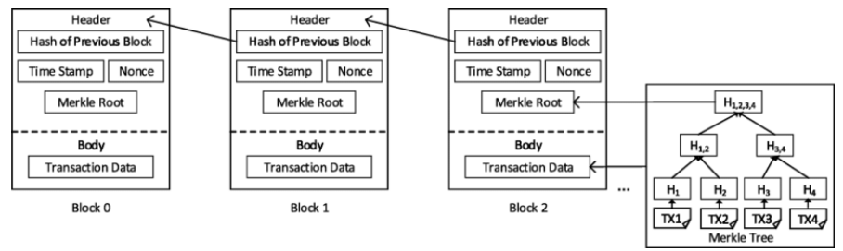
Structure of Blockchain

Slide 5
Generic elements of a blockchain
ADDRESSES
Unique identifiers (Sender , Receiver) that are used in a transaction on the blockchain.
A public key or derived from a public key Algorithm
As a good practice it is suggested that users generate a new address for each transaction in order to avoid linking transactions to the common owner, thus avoiding identification.

Slide 6
Generic elements of a blockchain
TRANSACTION
Fundamental unit of a blockchain.
Represents a transfer of value from one address to another.
BLOCK
A block is composed of multiple transactions and some other elements such as the previous block hash (hash pointer), timestamp, and nonce.

Slide 7
Nonce
In blockchain, a nonce (short for "number used once") is a random or pseudo-random number that is used in the mining process to find a valid hash for a new block.
It's a crucial component of the proof-of-work (PoW) consensus mechanism used in many cryptocurrencies like Bitcoin.
The nonce, along with other block data, is fed into a cryptographic hash function, and the miner's goal is to find a nonce value that produces a hash output meeting specific criteria (e.g., starting with a certain number of zeros).

Slide 8
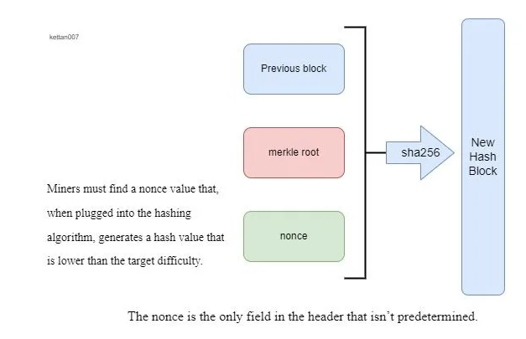

Slide 9
Generic elements of a blockchain
NODES
Performs various functions depending on the type of the blockchain used and the role assigned to the node.
Types of node: Full Nodes ,Light Nodes
Full nodes: Store a complete copy of the Blockchain ledger
Light nodes: Only store the necessary data to verify transactions.
Miners: Find the valid block, store a copy and distribute it to other nodes) – Powerful Computers / hardware
Validation of Transactions
Gathering transactions for a Block
Broadcasting a valid transaction and block
Consensus on next block creation
Chaining of blocks

Slide 10
Generic elements of a blockchain
SMART CONTRACTS
These programs run on top of the blockchain and
encapsulate the business logic to be executed when certain conditions are met.
The smart contract feature is not available in all blockchains but is now becoming a very desirable feature due to the flexibility.

Slide 11

SMART CONTRACTS

Slide 12
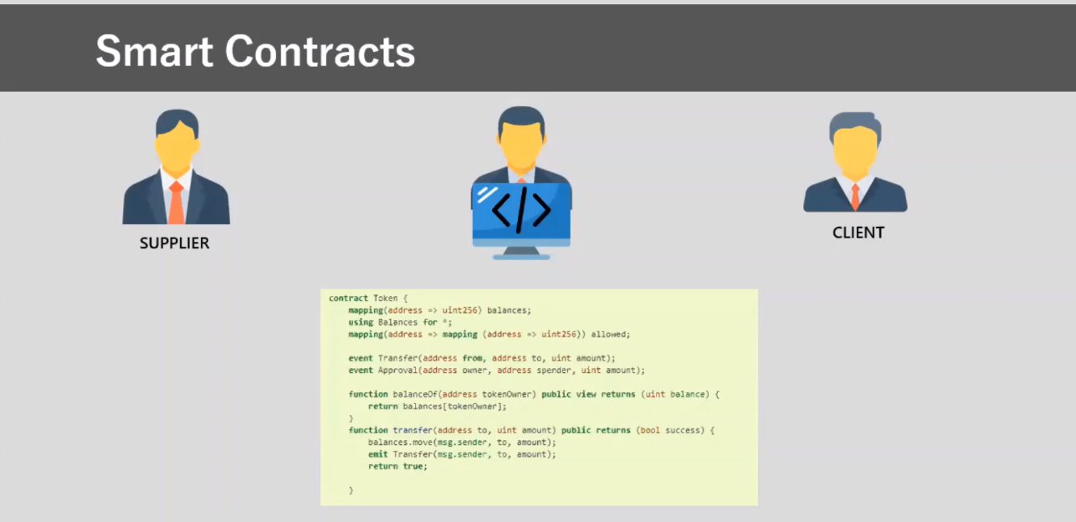
SMART CONTRACTS

Slide 14


Slide 15
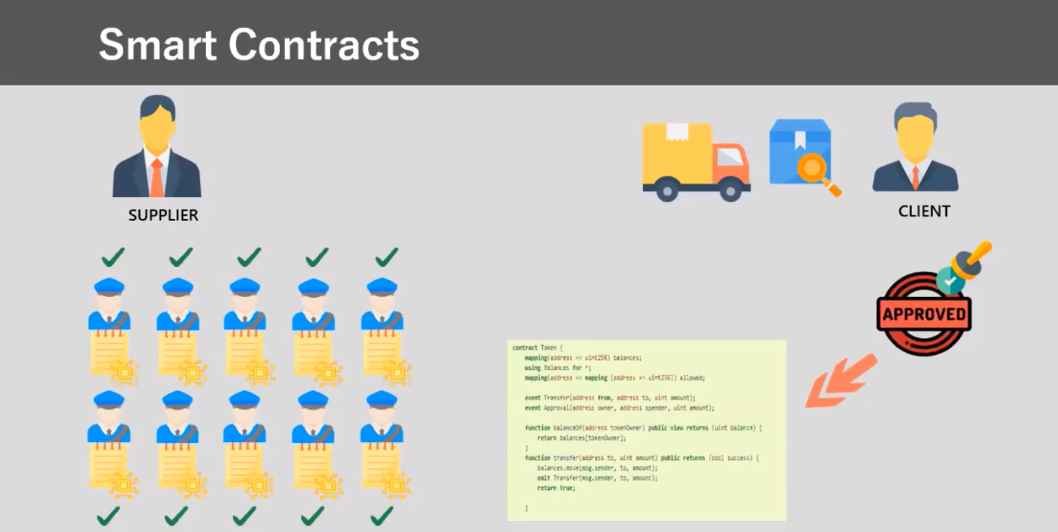

Slide 16
Generic elements of a blockchain
VIRTUAL MACHINE
It is an extension of a transaction script
Allows Turing complete code to be run on a Blockchain
Various blockchains use virtual machines to run programs, for example Ethereum Virtual Machine (EVM) and Chain Virtual Machine (CVM).

Slide 17
Generic elements of a blockchain
STATE MACHINE
Blockchain can be viewed as a state transition
mechanism.
A state is modified from its initial form to the next and eventually to a final form as a result of a transaction execution and validation process by nodes.

Slide 18
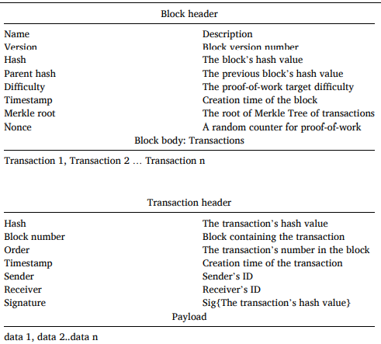
Block structure

Slide 19
Consensus Mechanisms
Consensus: It is a process of agreement between distrusting nodes on a final state of data.
This concept of achieving consensus (agree on a single value) between multiple nodes is known as distributed consensus.
A consensus mechanism is a set of steps that are taken by all, or most, nodes in order to agree on a proposed state or value.

Slide 20
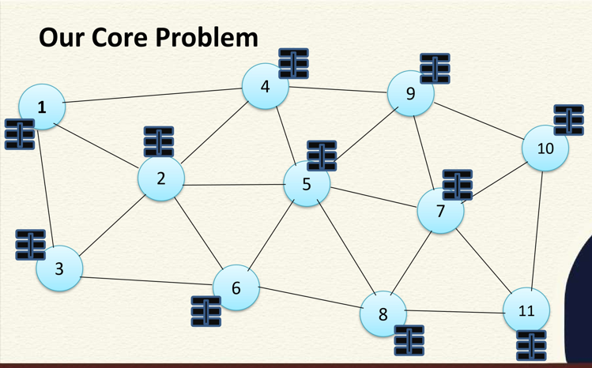
Classical Distributed Consensus Problem

Slide 21
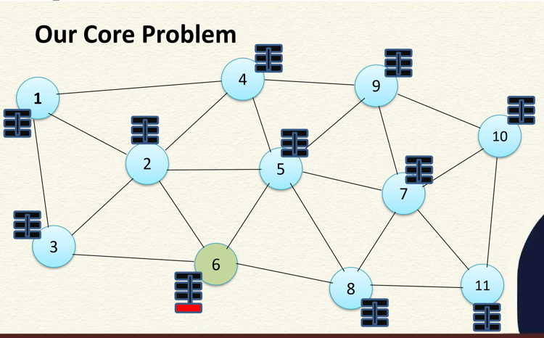
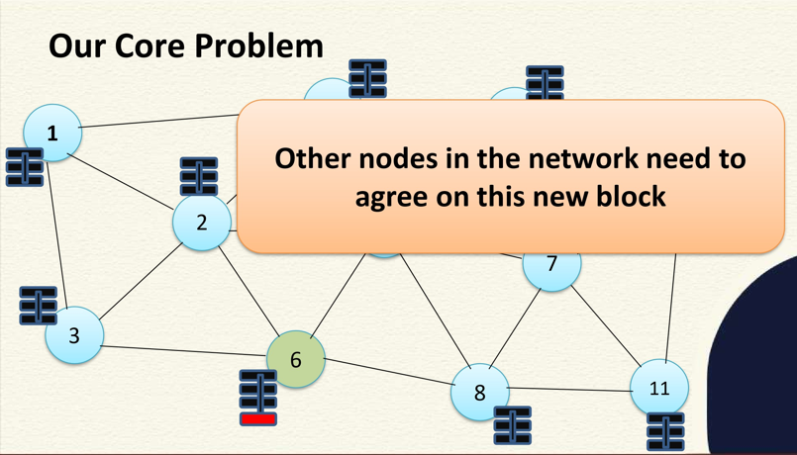
Classical Distributed Consensus Problem

Slide 22
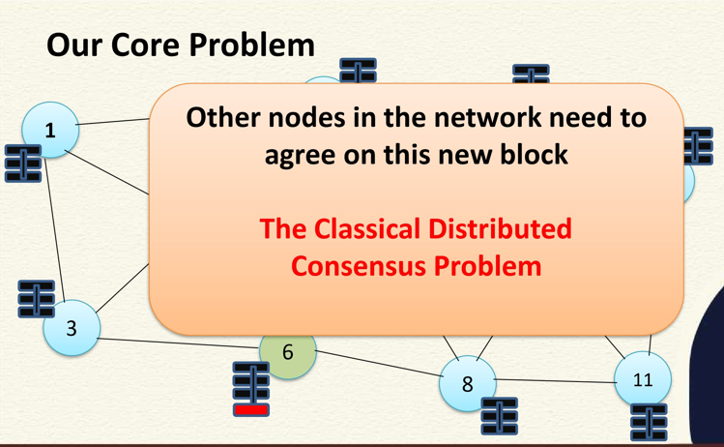

Slide 23
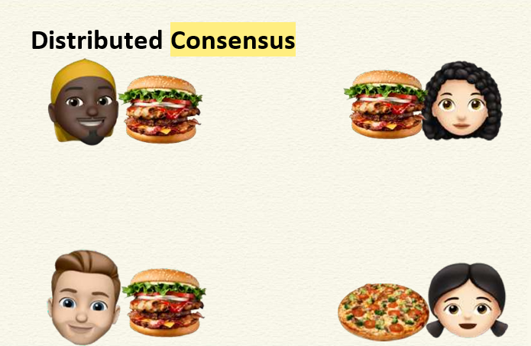
Distributed Consensus

Slide 24
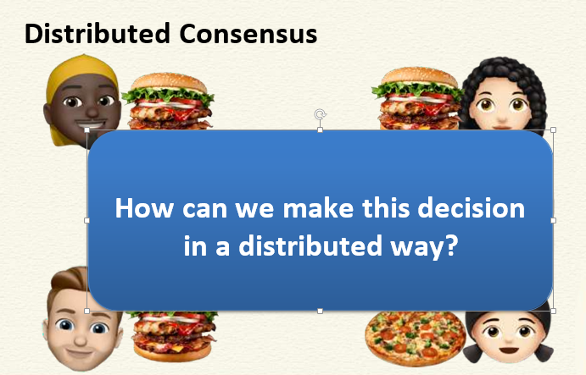
Distributed Consensus

Slide 25
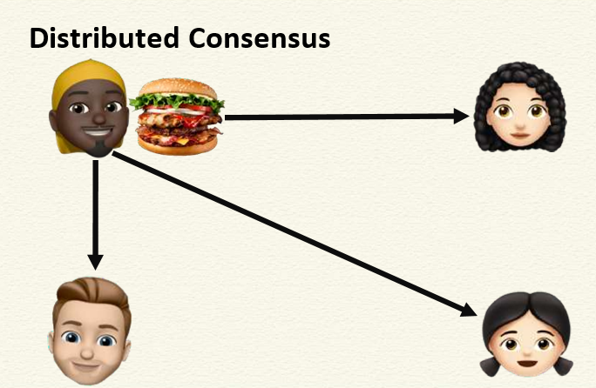
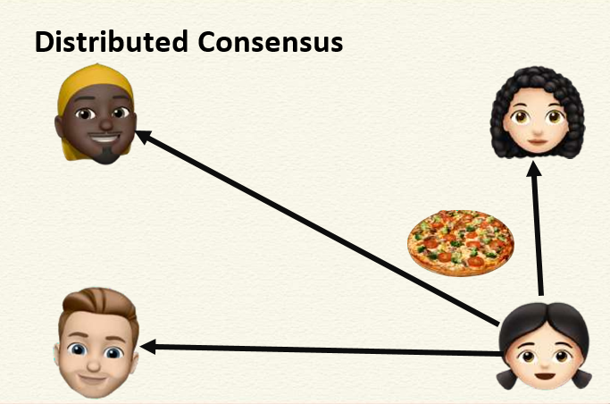
Distributed Consensus

Slide 26
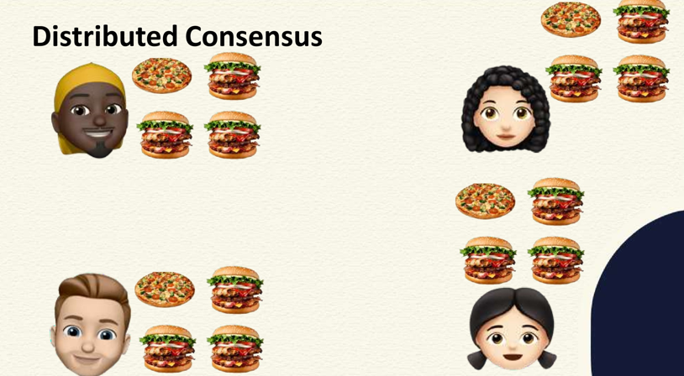
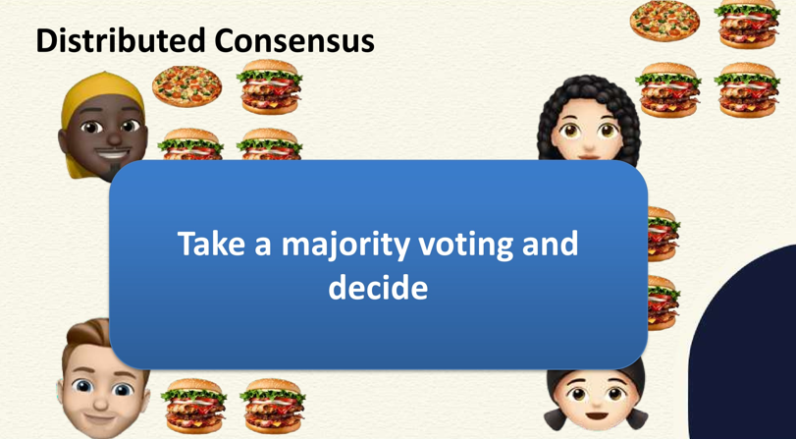
Distributed Consensus

Slide 27
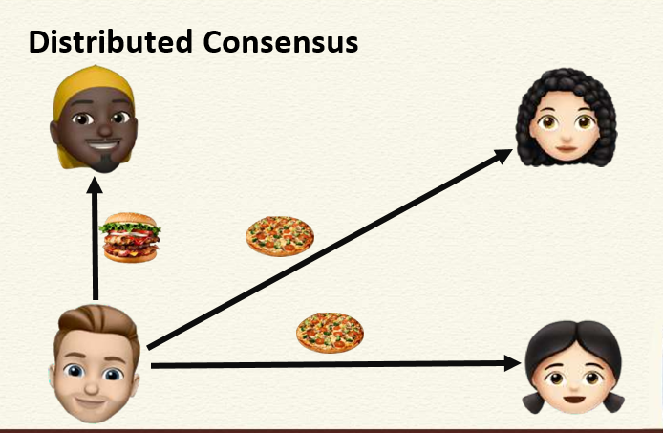
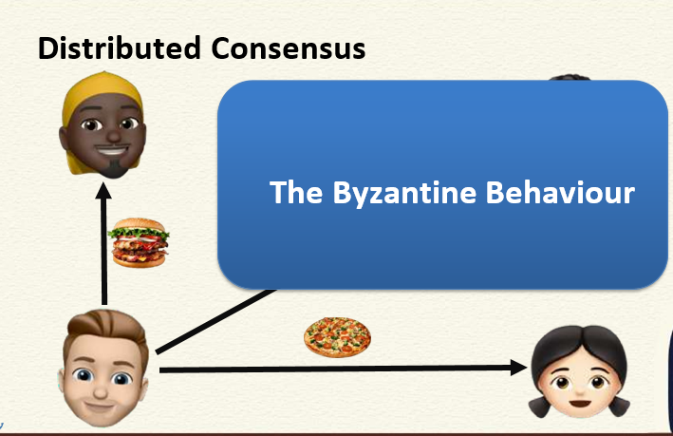

Slide 28
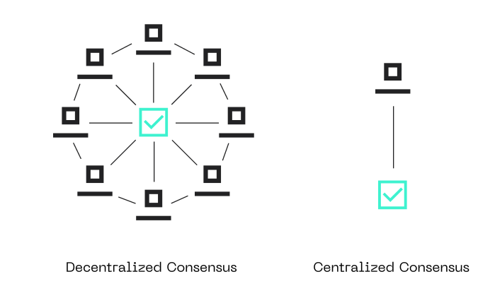
Consensus Mechanisms
Process prevents errors and secures the network against threats such as double-spending or Sybil attacks

Slide 29
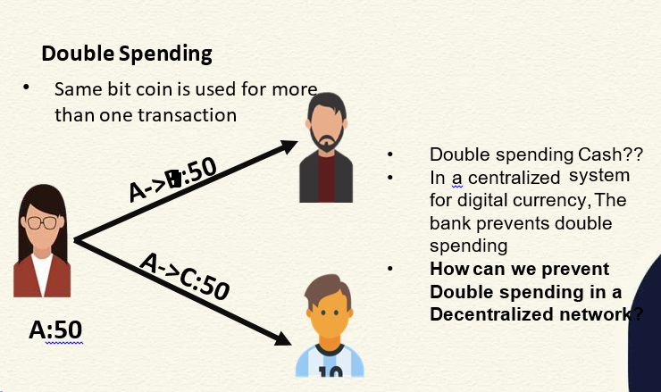
Double Spending

Slide 30
CONSENSUS MECHANISMS
More than three decades this concept has been researched by computer scientists in the industry and academia
Consensus mechanisms have recently come into the limelight and gained much popularity with the advent of bitcoin and blockchain
There are various requirements which must be met in order to provide the desired results in a consensus mechanism.

Slide 31
Consensus Requirements
Agreement: All honest nodes decide on the same value.
Termination: All honest nodes terminate execution of the consensus process and eventually reach a decision.
Validity: The value agreed upon by all honest nodes must be the same as the initial value proposed by at least one honest node.
Fault tolerant: The consensus algorithm should be able to run in the presence of faulty or malicious nodes (Byzantine nodes).
Integrity: This is a requirement where by no node makes the decision more than once. The nodes make decisions only once in a single consensus cycle.

Slide 32
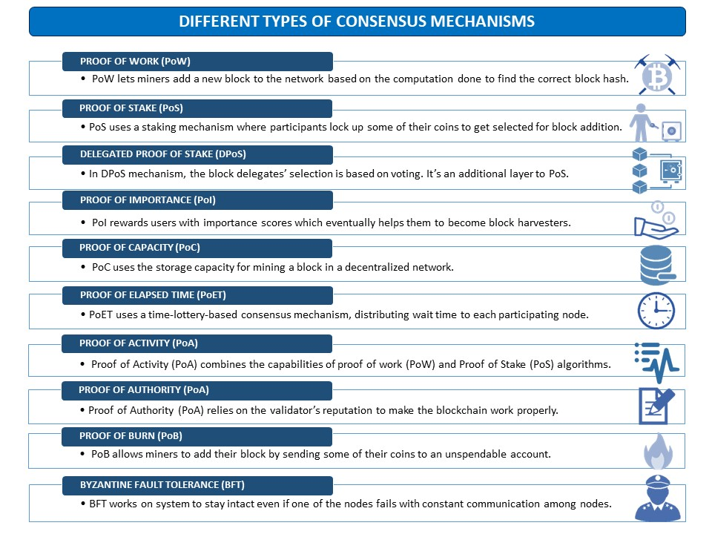
Types of Consensus Mechanisms

Slide 33
TYPES OF CONSENSUS MECHANISM
Byzantine fault tolerance-based: With no compute intensive operations such as partial hash inversion, this method relies on a simple scheme of nodes that are publishing signed messages.
Eventually, when a certain number of messages are received, then an agreement is reached.
Leader-based consensus mechanisms: This type of mechanism requires nodes to compete for the leader-election lottery and the node that wins it proposes a final value.

Slide 34
Types of Consensus Mechanisms
Many practical implementations have been proposed such as Paxos, the most famous protocol introduced by Leslie Lamport in 1989.
In Paxos nodes are assigned various roles such as Proposer, Acceptor, and Learner.
Nodes or processes are named replicas and consensus is achieved in the presence of faulty nodes by agreement among a majority of nodes.
Alternative to Paxos is RAFT, which works by assigning any of three states, that is, Follower, Candidate, or Leader, to the nodes.
A Leader is elected after a candidate node receives enough votes and all changes now have to go through the Leader, who commits the proposed changes once replication on the majority of follower nodes is completed.

Slide 35
TYPES OF CONSENSUS MECHANISM
Proof Of Work: is one of the earliest consensus algorithms, which works based on game theory.
Many popular blockchains adopted it, including Bitcoin, Litecoin, and Dogecoin.
There are high-level computational tasks that miners have to do in discovering new blocks, called mining.

Slide 36
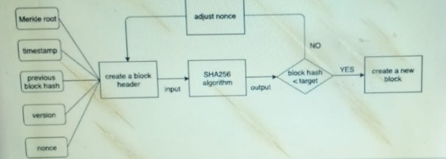
Proof Of Work(PoW)

Slide 37
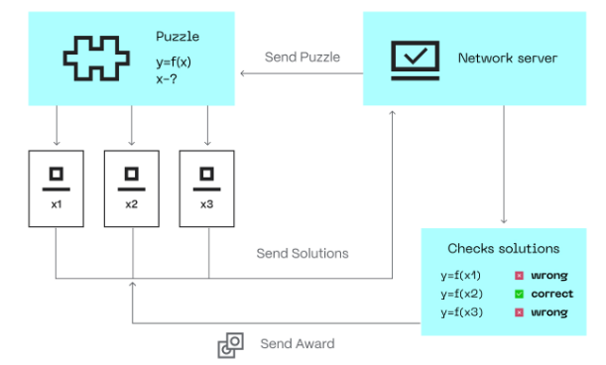
Proof Of Work(PoW)
Imagine there is a puzzle tournament and whoever solves it first wins the game. The grid was 9 x 9 at the start, but the organizers increased it to 27 x 27 as hundreds of people joined. Thus, making it harder to solve. Some of the participants developed custom machines to automate the solution. This will give them a higher chance of winning, right?

Slide 38
Proof of Stake (PoS)
PoS: consensus eliminates the high energy consumption by PoW. PoS uses a staking mechanism in which miners (or validators) hold some of their earned coins in the network to get selected for adding a block.
It was developed as a better option for PoW. In 2022, Ethereum dropped PoW for PoS because it is more energy-efficient and decentralized.
Other prominent blockchains, such as Ethereum 2.0 Tezos and Cardano, also incorporated PoS into their protocols.

Slide 39
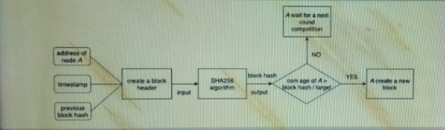

Slide 40
Workflow of a PoS-based mechanism
Nodes perform transactions. The PoS algorithm puts all these transactions into a pool.
2. All nodes fighting to become validators for the next block raise the stake.
This stake is combined with other factors such as “coin age” or “ random block selection” to select a validator.
Coin-age-based selection: The algorithm keeps track of how long each candidate validator node remains a validator. The older the node, the higher the chance of becoming a new validator.
Random Block selection: The validator is selected by combining “lowest hash value” and “highest stake.” The node that has the best-weighted combination of them becomes the new validator.
3. The validator verifies all transactions and publishes the block. His bet remains locked, and the forgery reward has also not yet been awarded. This is so that nodes in the network can “OK” a new block.
4. The validator will get the stake back and the reward if the block is OK. If the algorithm uses a mechanism based on coin age to select validators, the validator for the current block has its coin age reset to 0. This puts it in low priority for the next validator election.
5. If other nodes in the network do not validate the block, the validator loses his stake and is marked as “bad” by the algorithm. The process starts again from step 1 to create a new block.

Slide 41
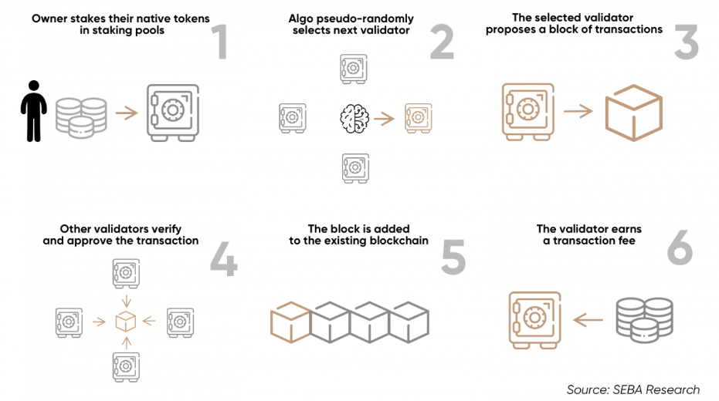
How staking works in PoS

Slide 42
Proof of elapsed time (PoET)
Developed by Intel Corporation that enables permissioned blockchain networks to determine who creates the next block.
PoET follows a lottery system that spreads the chances of winning equally across network participants, giving every node the same chance.
The PoET algorithm generates a random wait time for each node in the blockchain network; each node must sleep for that duration.
The node with the shortest wait time will wake up first and win the block, thus being allowed to commit a new block to the blockchain.
The PoET workflow is similar to Bitcoin's proof of work (PoW) but consumes less power because it allows a node to sleep and switch to other tasks for the specified time, thereby increasing network energy efficiency.

Slide 43
Proof of Capacity (PoC)
PoC is also known as proof of space, is a consensus mechanism in the blockchain. Unlike Proof of Work (PoW) which uses separate mining hardware for computing power, or Proof of stake (PoS), which stakes miners’ coins.
PoC allows network participants (nodes) to use their available hard drives space for mining a new block and validating transactions.

Slide 44
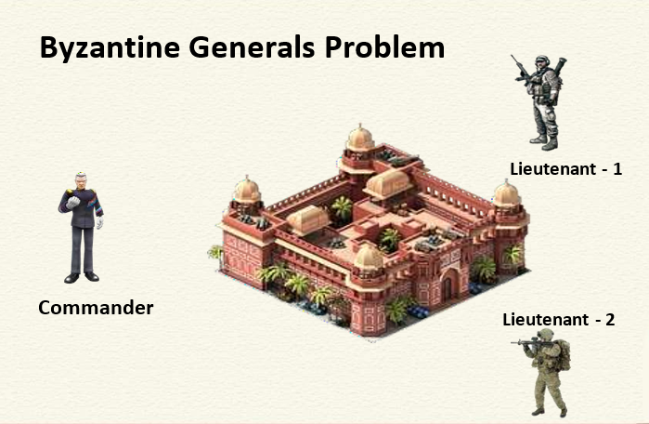
Byzantine General problem

Slide 45
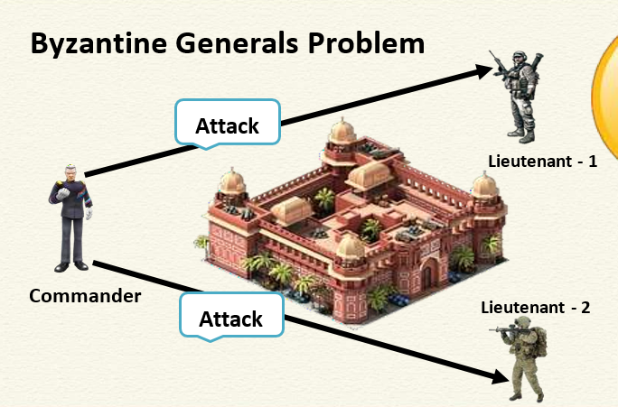
Byzantine General problem

Slide 46
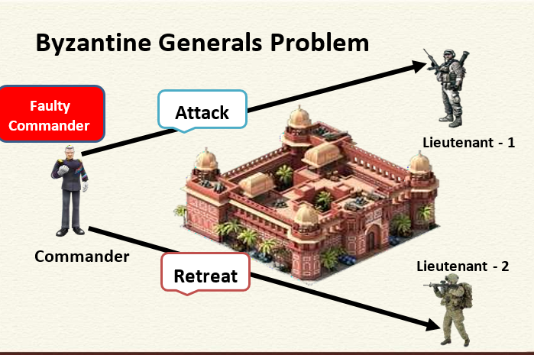

Slide 47
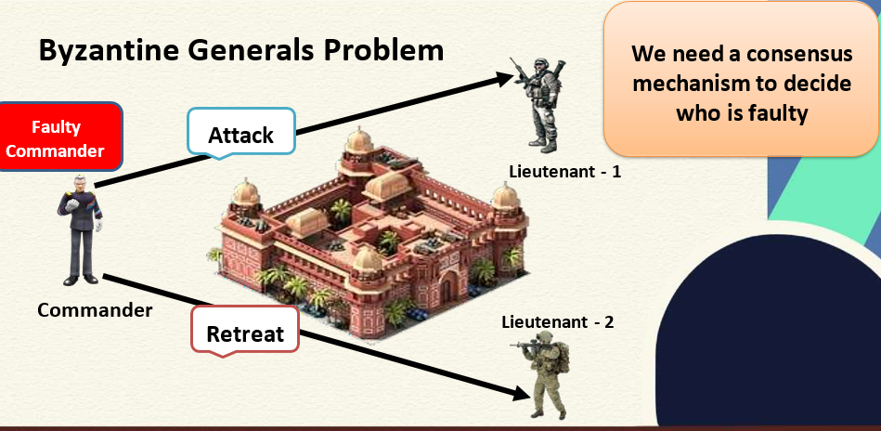

Slide 48
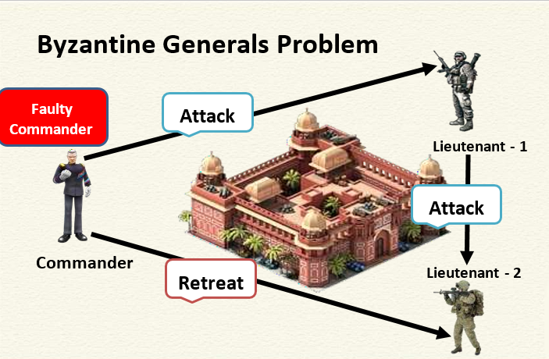

Slide 49
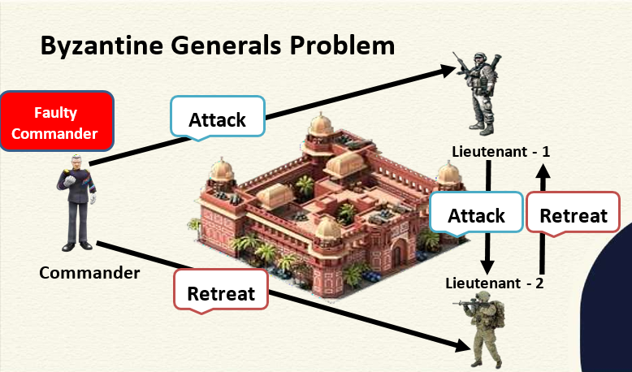

Slide 50
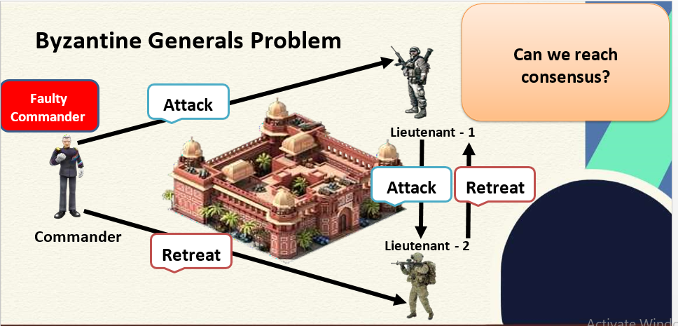

Slide 51
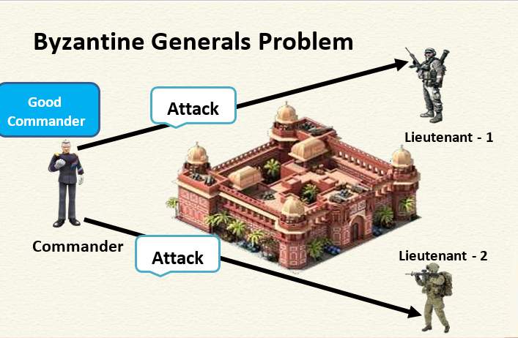

Slide 52
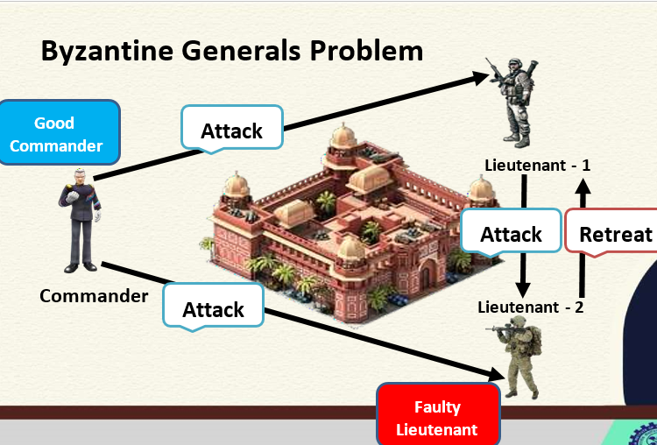

Slide 53
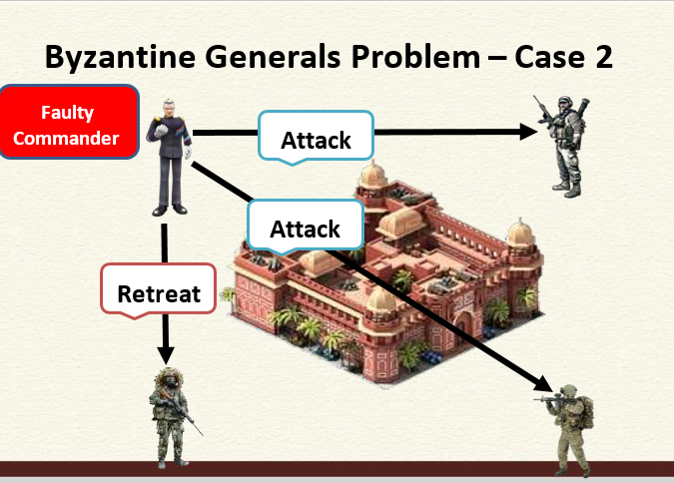
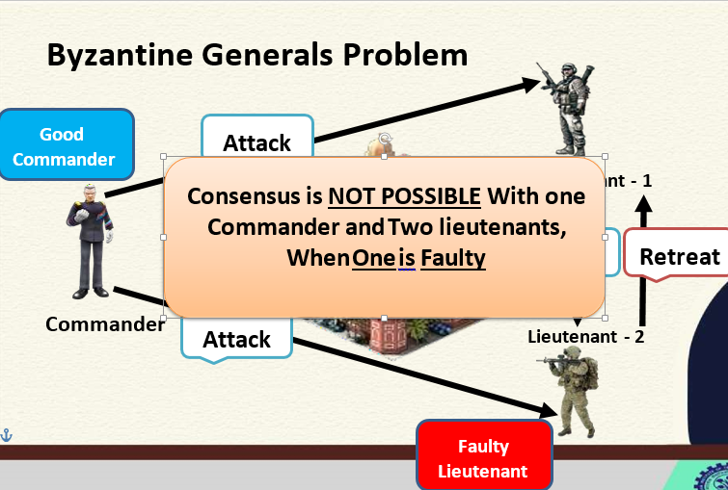

Slide 54
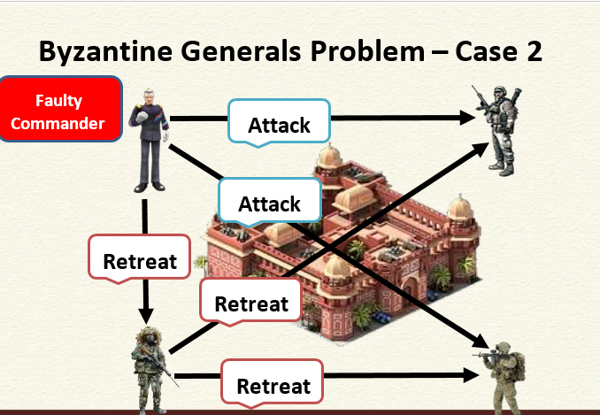
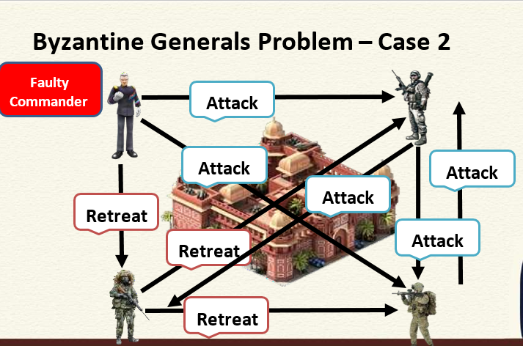

Slide 55
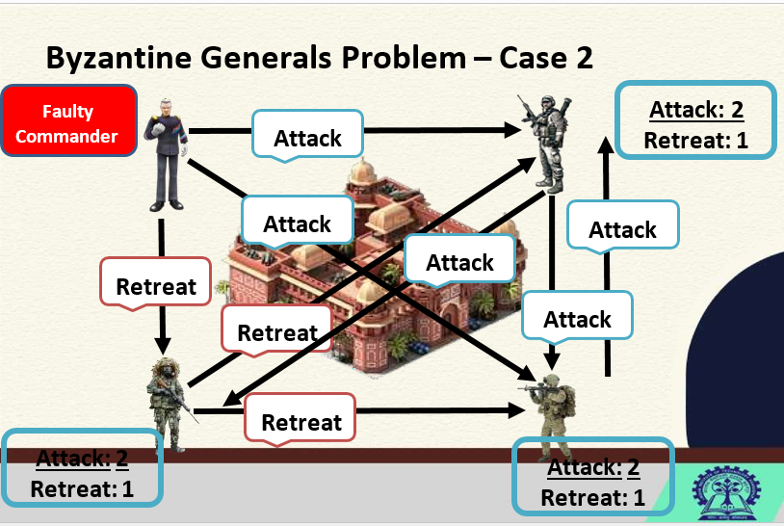
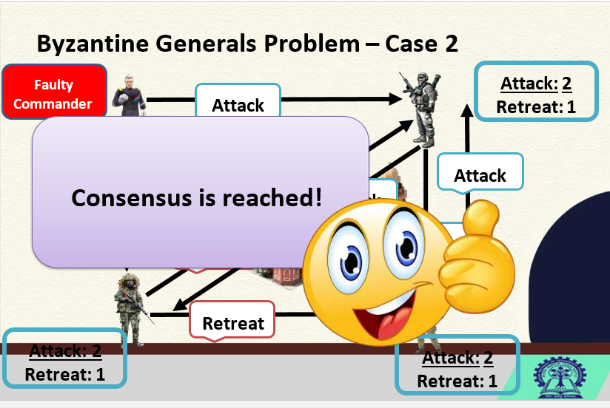

Slide 56
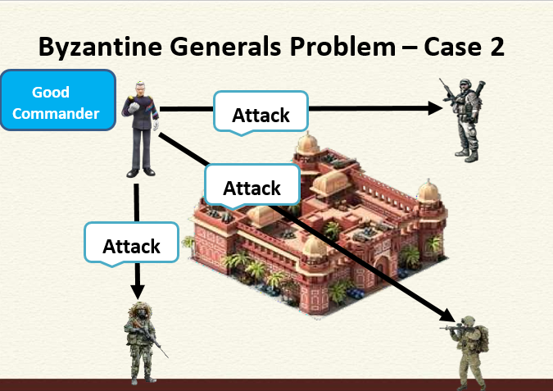
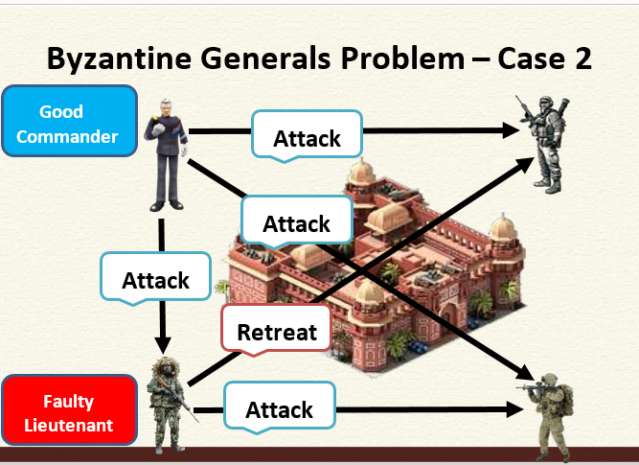
Faulty Lieutenant

Slide 57
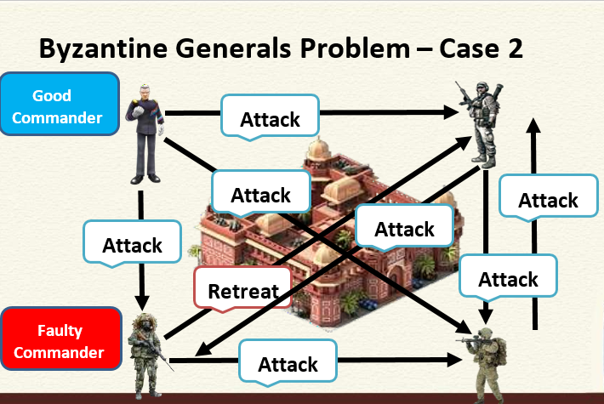
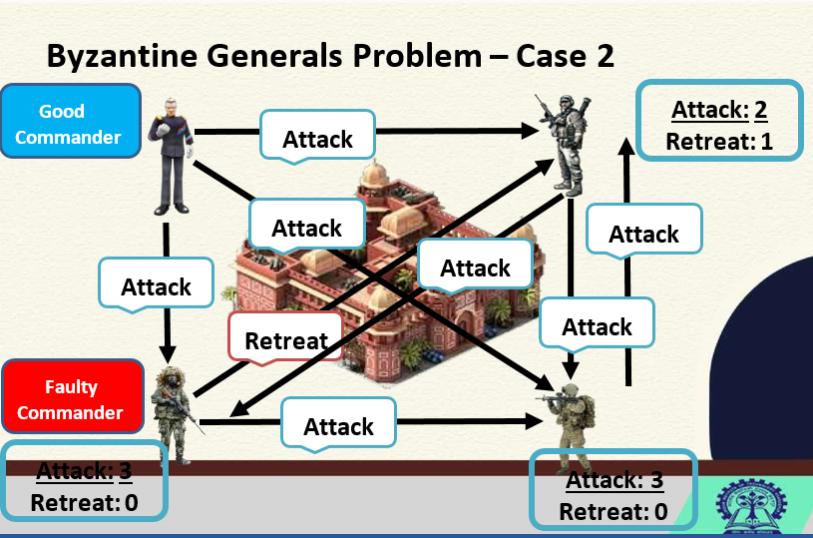

Slide 58
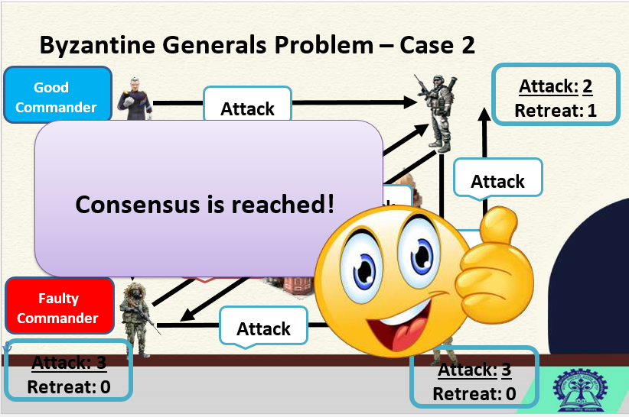
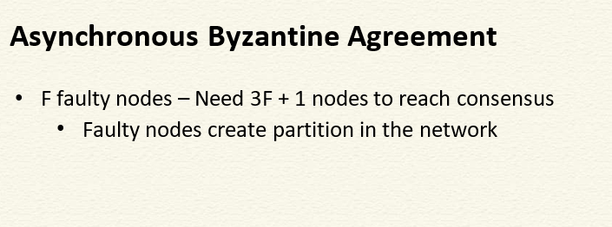

Slide 59
Byzantine Fault Tolerance
Byzantine Fault Tolerance(BFT) is the feature of a distributed network to reach consensus (agreement on the same value) even when some of the nodes in the network fail to respond or respond with incorrect information.
The objective of a BFT mechanism is to safeguard against the system failures by employing collective decision making(both - correct and faulty nodes) which aims to reduce to influence of the faulty nodes.
BFT is derived from Byzantine Generals' Problem.

